Slide 1
Keeping Europe healthy
The European Centre for Disease Prevention and Control
Presenter, Unit
European Centre for Disease Prevention and Control
Stockholm, 18 January 2010

Slide 2
Epidemiological background

Slide 3
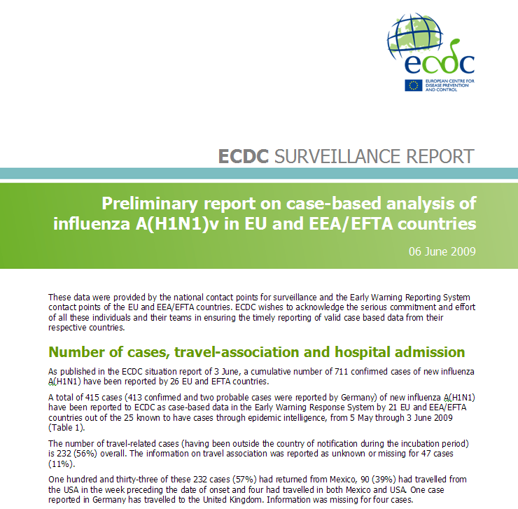
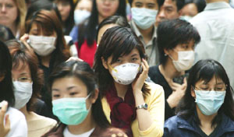
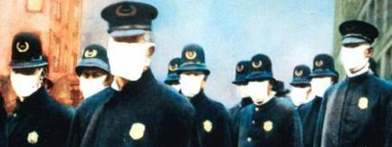
Epidemics still happen in our era
SARS in 2003 spread internationally at an alarming speed.
20th century saw influenza pandemics in 1918, 1957, 1968.
In June 2009, the WHO confirmed the A(H1N1)v influenza epidemic as a global pandemic.

Slide 4
Expanded Europe – the five freedoms in the EU
1. Free movement of people*
Free movement of services*
Free movement of goods*
4. Free movement of monies*
5. Free movement of microbes
Adapted from ‘Summary of Legislation — Internal Market’; http://europa.eu.int/scadplus/leg/en/s70000.htm

Slide 5


21st century trends
Emerging/re-emerging infectious diseases:
Emerging pathogens (e.g. chikungunya, BSE-v/CjD, Ebola, H5N1)
Resurgence of TB, measles, dengue, meningitis
Animal to humans
(e.g. Nipah virus, hanta virus, H5N1)
Change presents microbes with new opportunities:
Globalisation of travel and trade
Intentional use of biological agents
(e.g. anthrax)
Climate change

Slide 6
ECDC
The European Centre for Disease Prevention and Control

Slide 7

Why was ECDC established?
ECDC: A young EU agency dedicated to the prevention and
control of communicable diseases
Emerging and re-emerging communicable diseases revitalised through globalisation, bio-terrorism, interconnectivity, and an EU without internal borders
Health implications of enlarging EU
Strengthen EU public health capacity to help meet EU citizen's concerns
Notes:
All this has implications for the EU with porous external borders and no internal borders and the EU wanted to strengthen its public health capacity to protect its citizens.

Slide 8


What is ECDC?
An independent agency, named the European Centre for Disease Prevention and Control …
— ECDC Founding Regulation (851/2004)
A European Union Agency which:
is a member of the European Union (EU) family;
covers EU 27, EEA/EFTA countries;
reaches out to other countries beyond the EU 27 through Neighbourhood Policy and DG RELEX;
supports and promotes global health security (role in International Health Regulations); and
is financed through the EU budget.

Slide 9
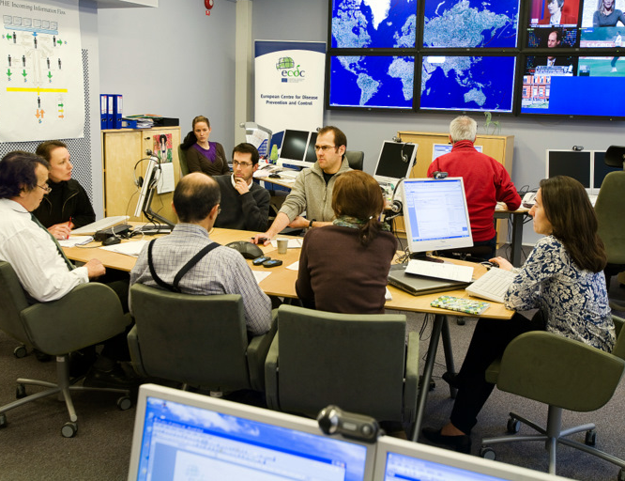
What is the role of ECDC?
Identify, assess and communicate current and emerging health threats to human health from communicable diseases.
— ECDC Founding Regulation (851/2004), Article 3
EU-level disease surveillance and epidemic intelligence
Scientific opinions and studies
Early Warning System and response
Technical assistance and training
Communication to scientific community
Communication to the public
Notes:
In the EU, public health is a shared competence. Our role is primarily in risk assessment and we have an advisory role in risk management which is primarily a Member State competence coordinated by the Commission.

Slide 10
Organisational structures

Slide 11

ECDC's strategic partners contribute to health security
Com-
mission
WHO
NGOs
Council
Research
community
European
Parliament
Other
countries
EU
agencies
Industry
Member
States
CDCs
Animated slide: Press space bar

Slide 12
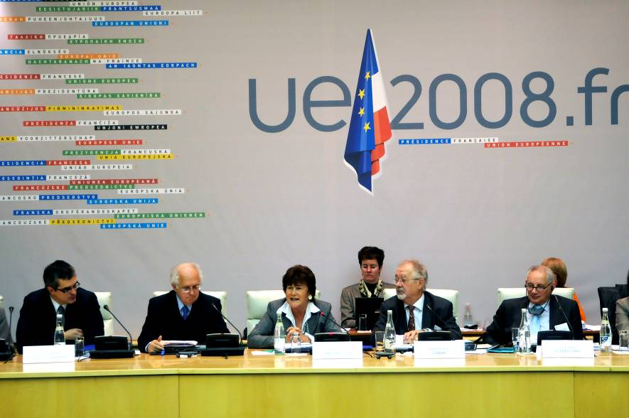
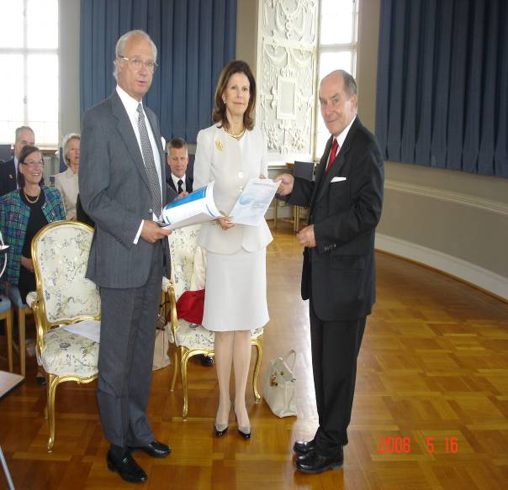
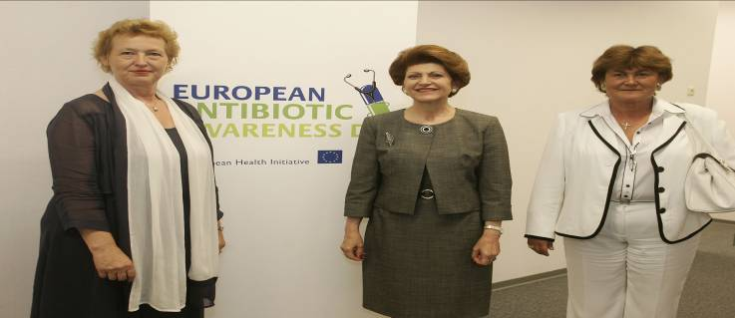
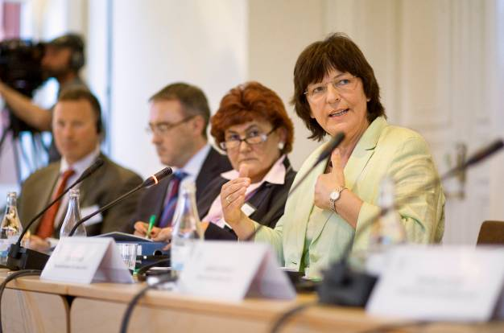


Working with the EU presidencies
Notes:
2007: Germany (First semester) – (Second semestrer)
2008: Slovenia (First semester) – France (Second semester)
2009: Czech Republic (First semester) – Sweden (Second semester)

Slide 13
ECDC
Director
Organisational
Chart
Director's Cabinet
Chief Scientist
Preparedness
and Response Unit (PRU)
Surveillance
Unit
(SUN)
Scientific Advice Unit
(SAU)
Health Communication Unit (HCU)
Administration Unit
(ADM)
Emergency Operation Centre (EOC) and
Preparedness
Section
ARHAI Section (SUN)
ARHAI Section (SAU)
Knowledge and Resource Centre on Health Communication
Legal Services and
Procurement
FWD Section (SUN)
FWD and EVD Section (SAU)
Internal Control Coordination
Epidemic Intelligence and
Response Section
Public Communication and Media Section
HASH Section (SUN)
HASH Section (SAU)
Human Resources Section
Training
Section
RTI Section (SUN),
incl. FLU and TB subsections
RTI Section (SAU),
incl. FLU and TB subsections
Scientific Communication Section
Financing and Accounting
Section
VPD Section (SUN)
VPD Section (SAU)
Web Services
Section
ICT and Project Support Section
Unit
Data Management and General Surveillance Section
Future Threats and Determinants
Section
Section
SE
Scientific and Technical Advice and Knowledge Services
Missions, Meetings
and Logistics Section
Special entities
DSP
Core Disease-Specific Programmes (DSPs)
(supported by other units)

Slide 14
Thank you!

